Slide 1
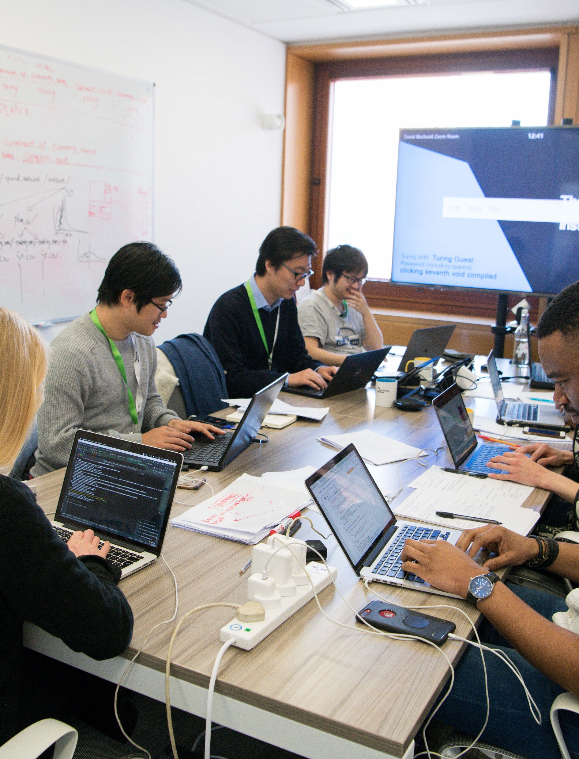
Data Study Groups at The Alan Turing Institute
The national institute for data science and artificial intelligence

Slide 2
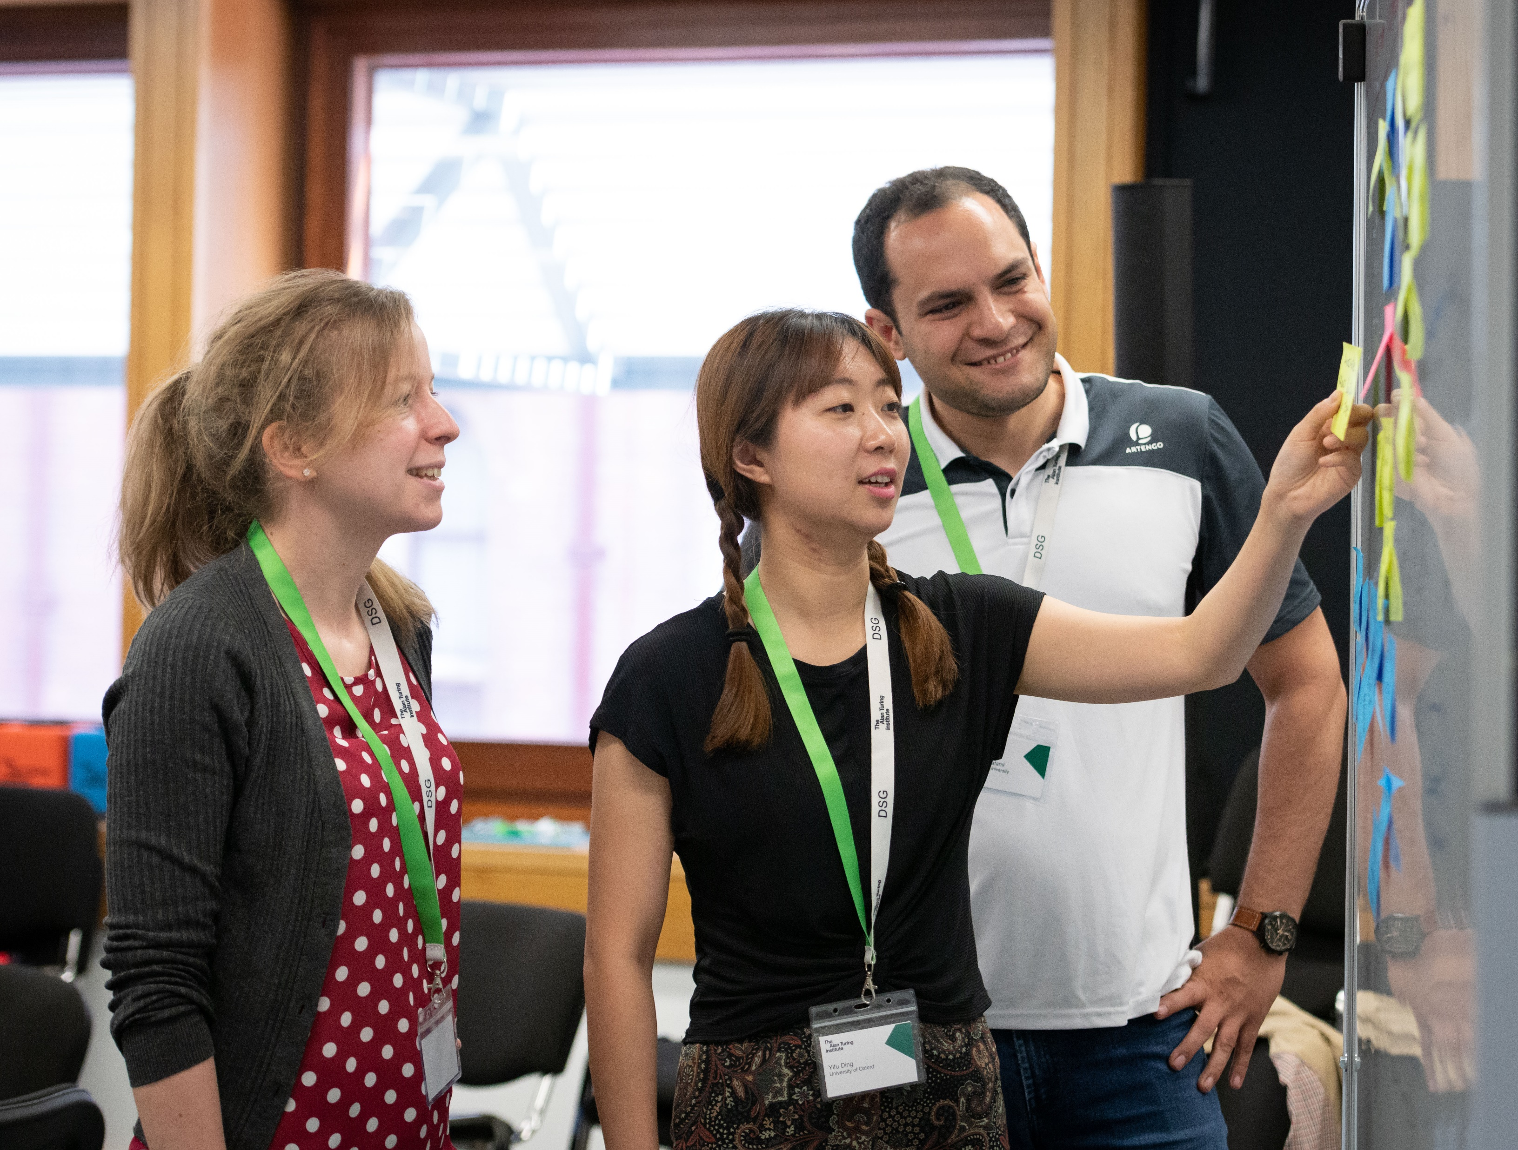
Collaborative Hackathons
Bring together organisations from:
Industry
Government
Third sector
With talented multi-disciplinary researchers from academia

Slide 3
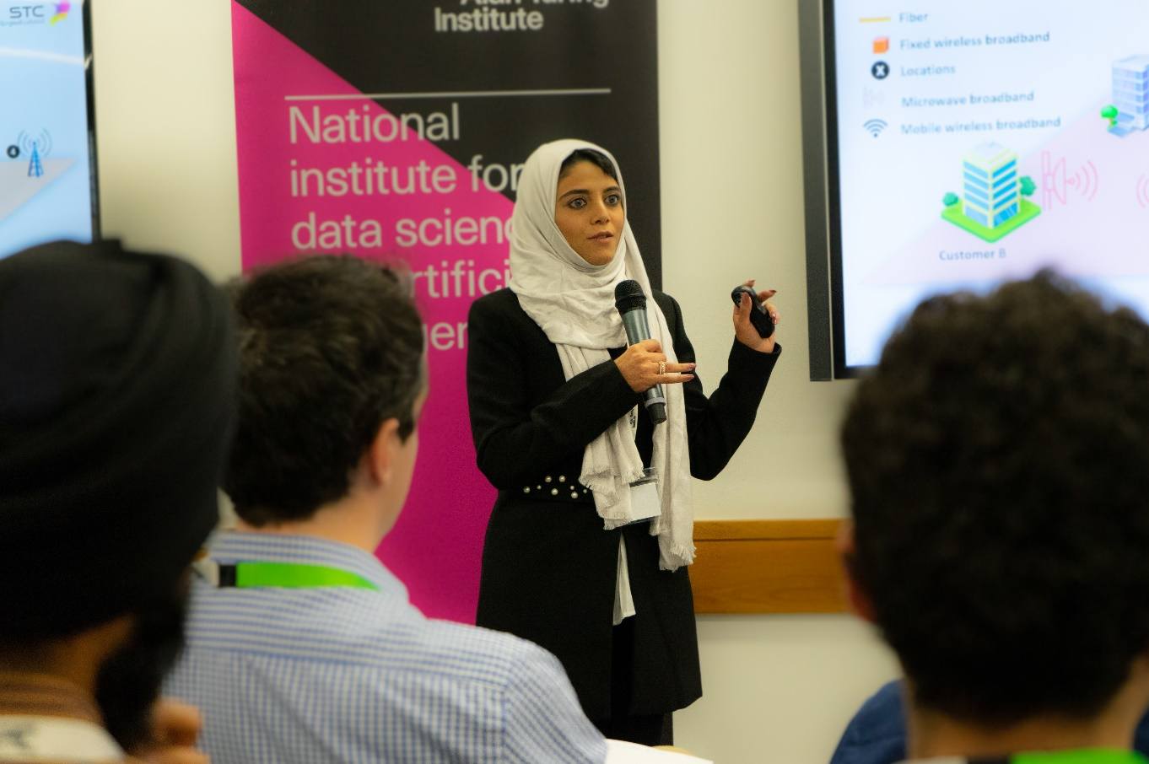
The week
Day 1: Challenges are presented by the organisation
Day 2-4: Brainstorming, modelling and problem solving
Day 5: Progress and recommended routes forward are presented.
Afterwards: Code & quality-controlled report and possible extension of collaboration

Slide 4
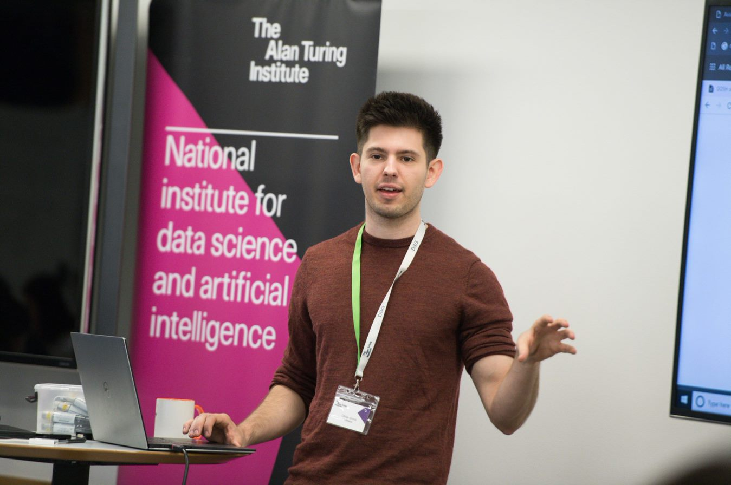
Preparation: Start with the end in mind
Outputs include:
a presentation
a report
code

Slide 5
What makes a great challenge?
A framework for exploration (this is not consultancy)
Can the question be tackled with data?
Is the challenge doable in 3.5 days?
Is the question challenging, non trivial?
We will help!

Slide 6
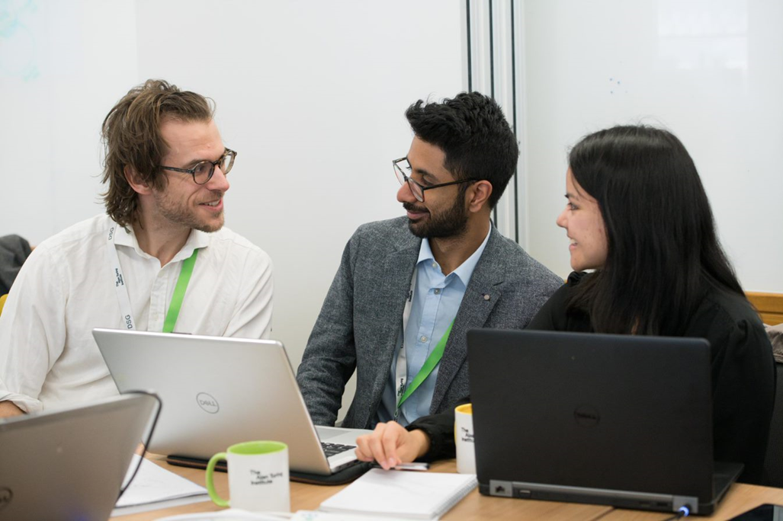
A proof of concept
Suggest routes towards follow-on collaborative research
You will not have a complete answer. But you will have some direction
Not answering the question is also valuable knowledge

Slide 7
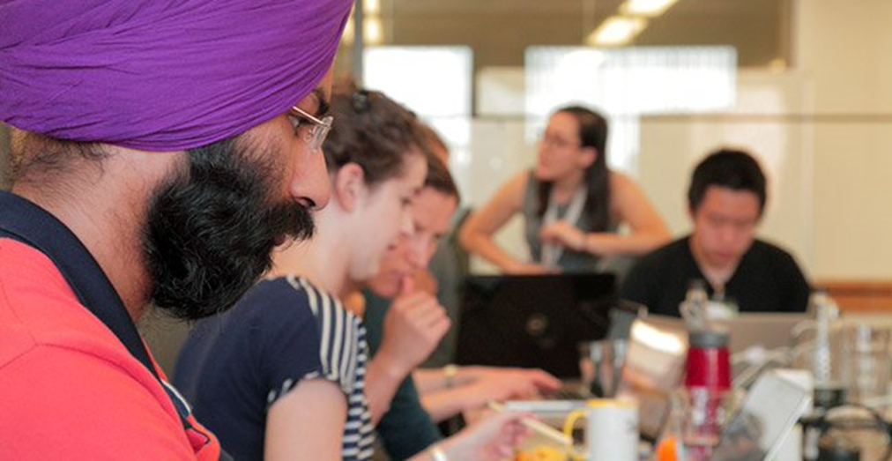
Get involved
Challenge owners are expected to collaborate closely with the Turing throughout the process:
Human resources
Data governance requirements
Embed with the study group during the week

Slide 8

Is your Data in good shape?
Considerations:
Quality & cleanliness - is there missing or inaccurate data?
Sensitivity
Size (Data points and physical)
Accessibility - how easy is it to get the data ready?
Richness - Can you add more data for a fuller picture?

Slide 9
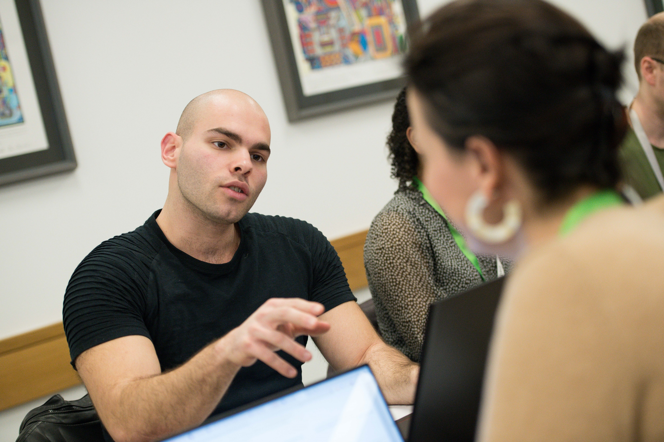
The DSG PI
A postdoc level researcher looking to engage with industry
The PI will help scope your problem into an academic DSG challenge
The PI focus is on the science (we do the admin)

Slide 10
Data Study Group Collaborative Research Agreement
Intellectual Property arising during DSG
We don’t expect any
All results will be published and any code developed will be made available under permissive open source license where possible
All of your data remains confidential
All of your background IP and that of our researchers, remains with the inventor
Publication and Impact
A report will be published on the Turing website
As a Challenge Owner, you have the opportunity to review the report prior to publication, for minor redactions relating to confidentiality

Slide 11
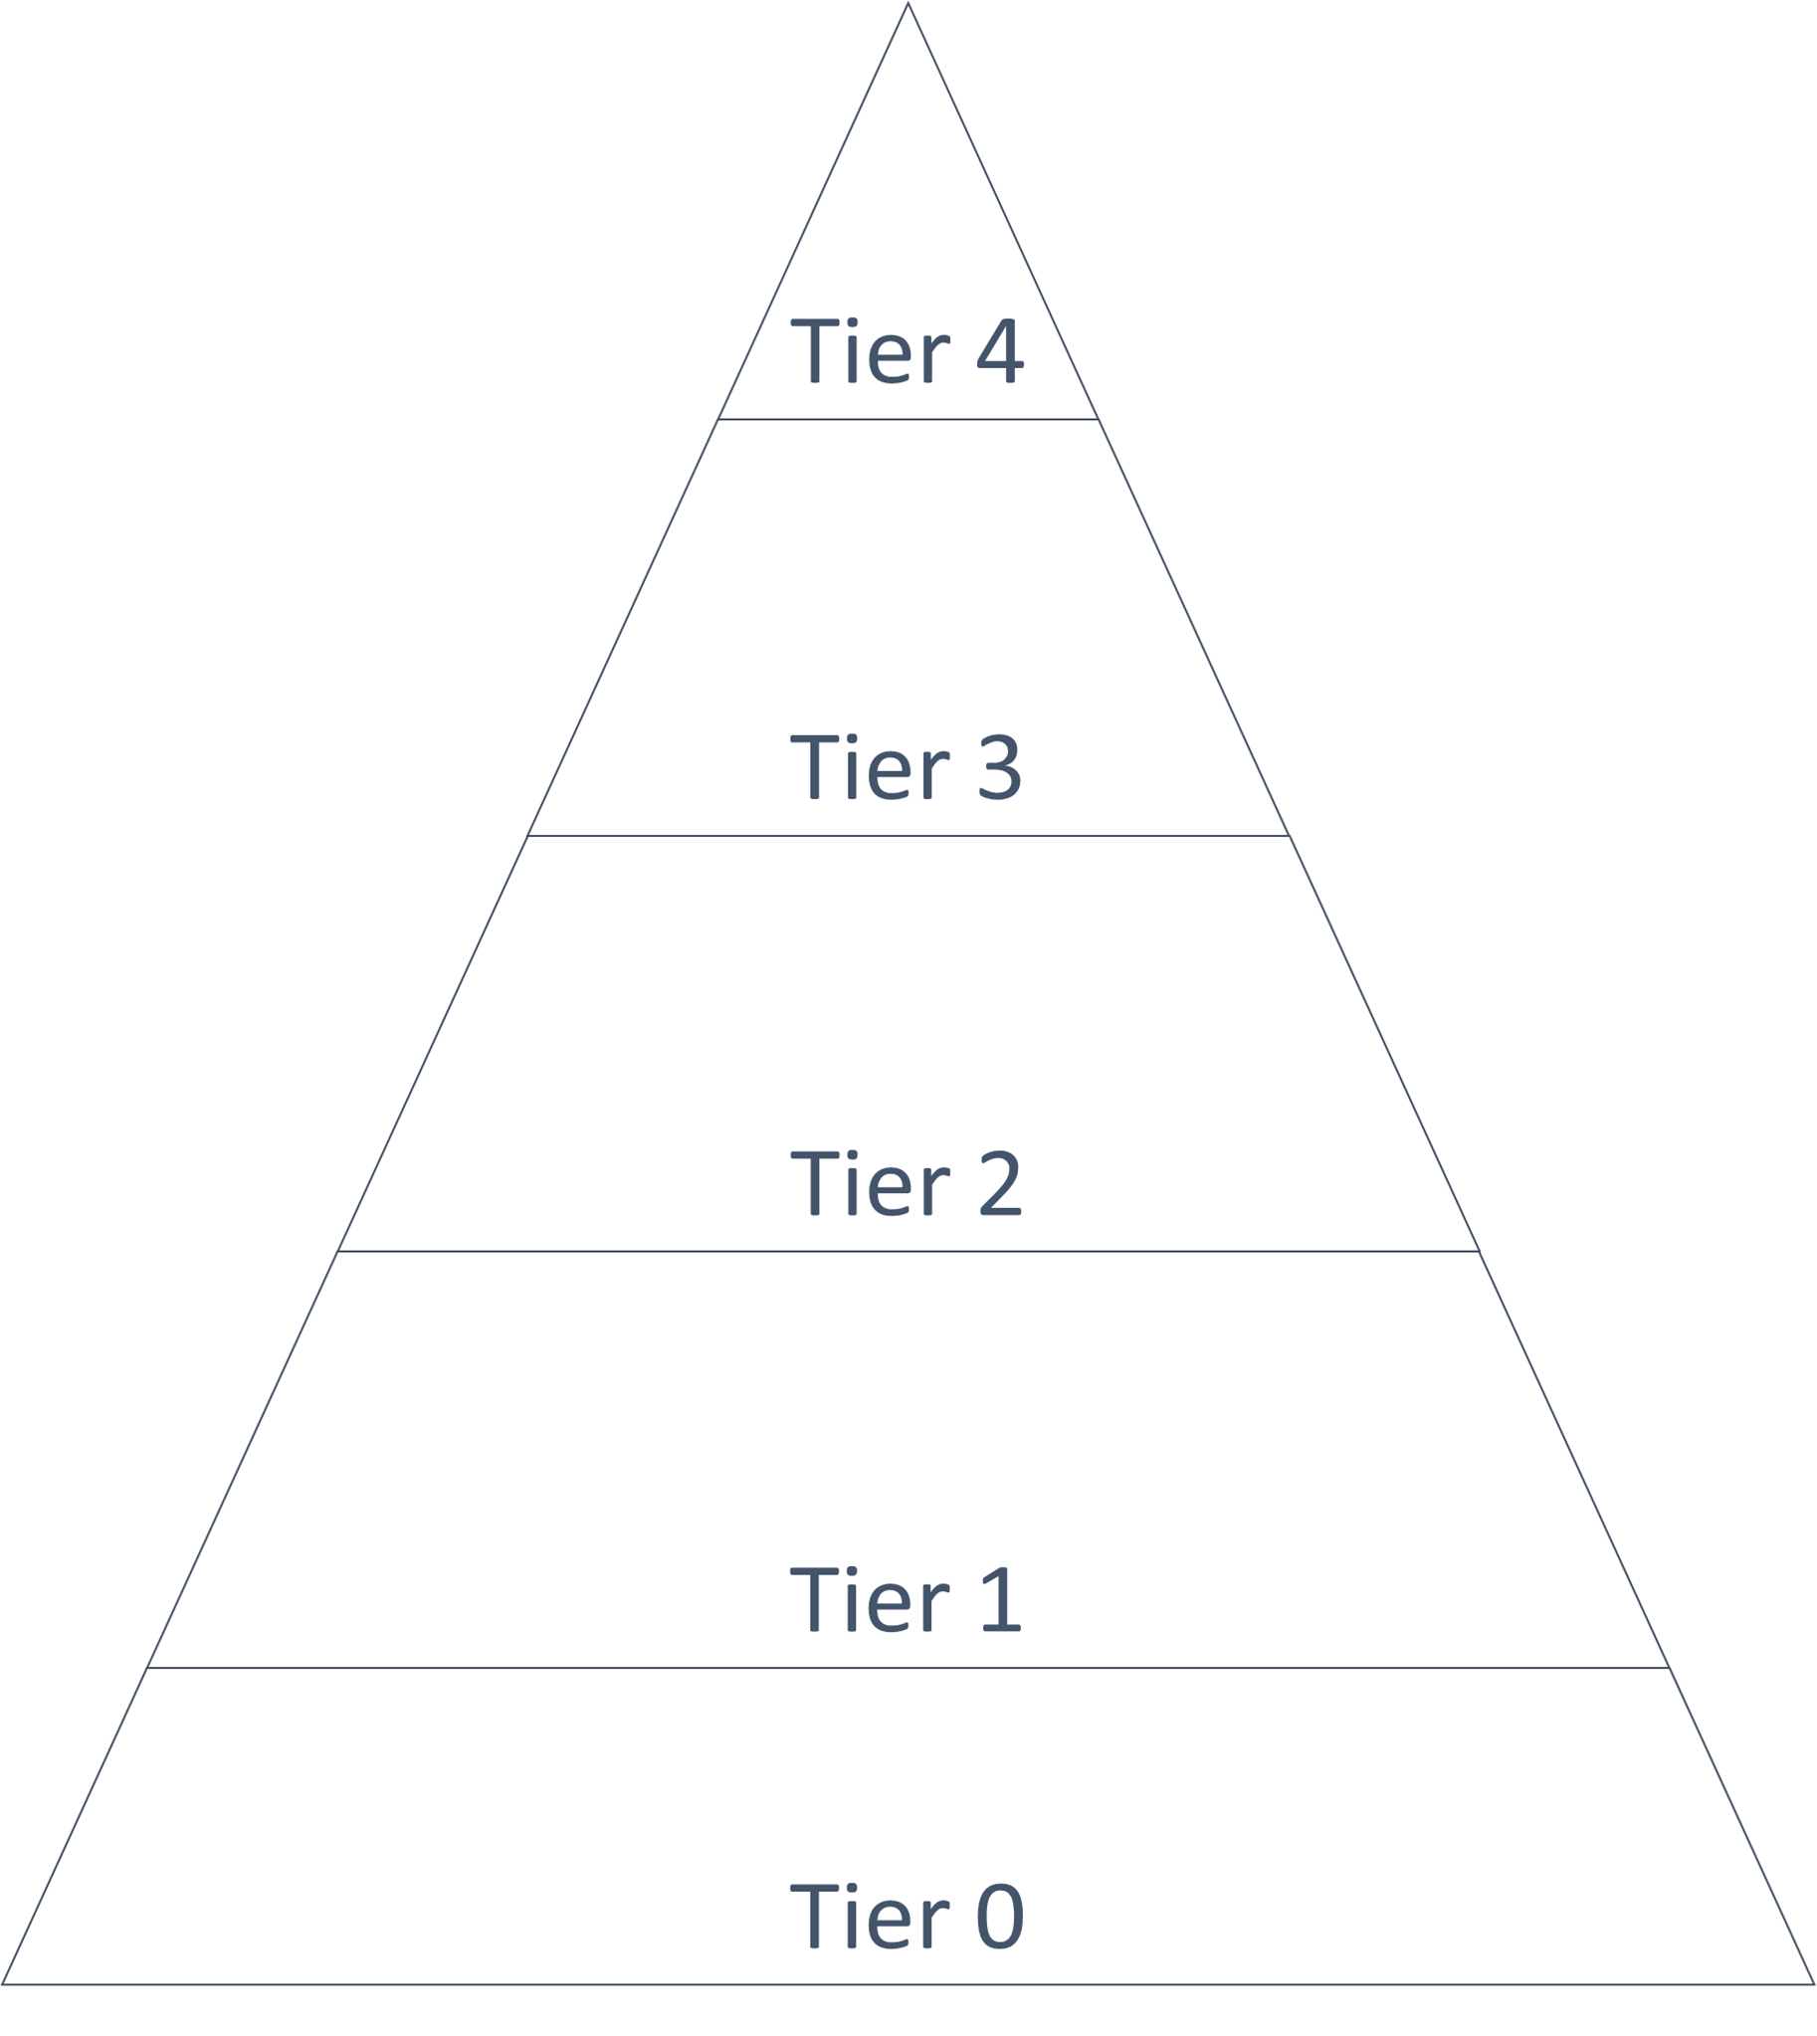
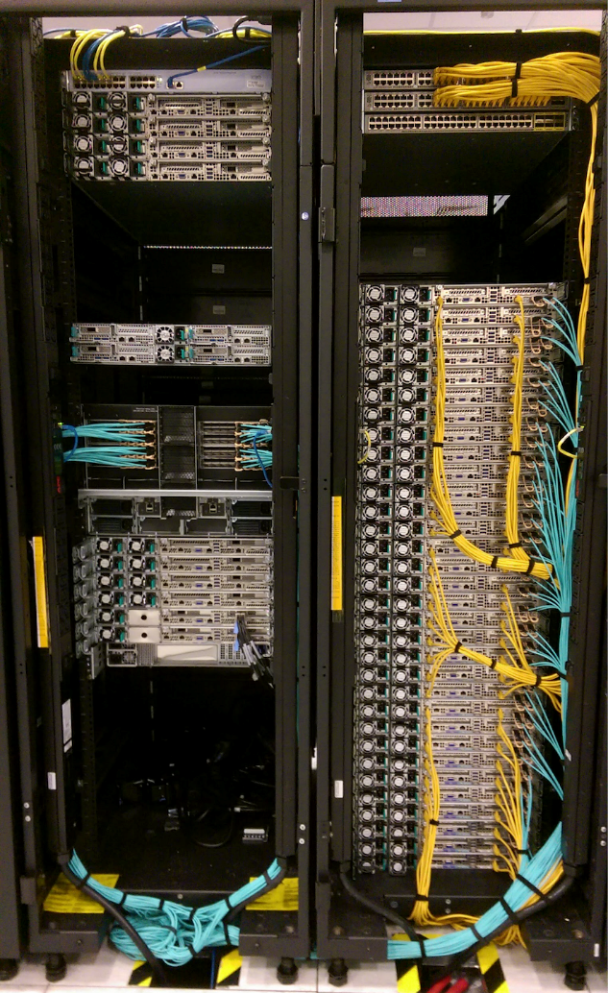
Protecting your data – The Turing safe haven
Your data will be stored in the Turing safe haven.
Safe havens are secure research environments that sit on top of Azure
They range in security features depending on the sensitivity of the project
In preparation for the event you will have to assess your data

Slide 12
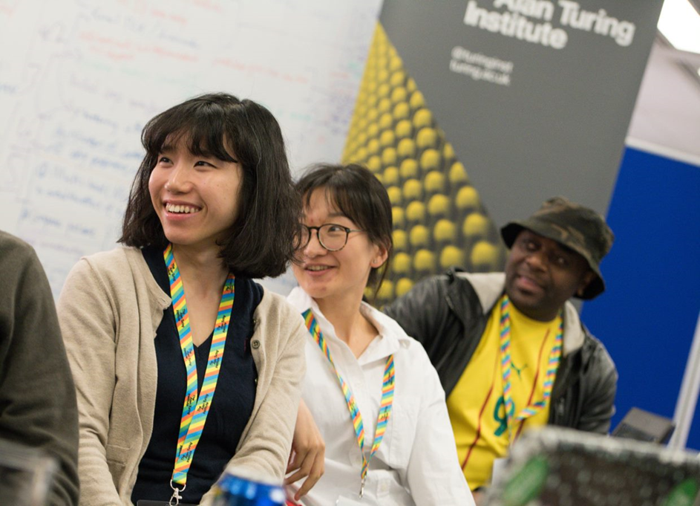
Next steps (to join the pipeline)
Complete the challenge proposal form
It does not need to be perfect!
Submit to the DSG team (or your programme lead)

Slide 13
https://www.turing.ac.uk/collaborate-turing/data-study-groups

